Slide 1
Unit 3 Interaction Modeling

Slide 2
Unit 3 7 Hours
Interaction Modeling: Interaction Modeling: Use case models; Sequence models; Activity models.
Advanced interaction Modeling: Use case relationships; Procedural sequence models; Special constructs for activity models.

Slide 3
Interaction modeling
The class model describes the object in a system and their relationships
The state model describes the life cycle of the objects
The Interaction model describes how the objects interact .
The interaction model starts with Use cases that are then elaborated with sequence and activity diagrams.

Slide 4
Interaction Modeling
Interaction modeling describes how object interact to produce useful results. The term interact is a set of exchanged messages between the objects.
The interaction model can be modelled at different levels :-
Use case diagram (at high level use case describe how system interacts with outside actors)
Sequence diagram (provides more detail and show the messages exchanged among set of objects over time.)
Activity diagram (provide more detail and show the flow of control among the steps of a computation.)

Slide 5
Use Case models
Actors
A direct external user of a system
Not part of the system
For example Traveler, agent, and airline for a travel agency system.
Can be a person, devices and other system
An actor has a single well-defined purpose
Use Cases
A use case is a coherent piece of functionality that a system can provide by interacting with actors.
For example: A customer actor can buy a beverage from a vending machine.
A repair technician can perform scheduled maintenance on a vending machine.

Slide 6
Use Case Diagram
A UML diagram that represents the relationship between actors and use cases, and among the use cases.
Represents an “architectural” view of the requirements.
Actors :-
External entities (e.g. Object, user role, another system)
Relationship between actors and use cases :-
Initiation
Communication
Relationship among different use cases :-
Enables the decomposition of complex use cases into smaller ones

Slide 7
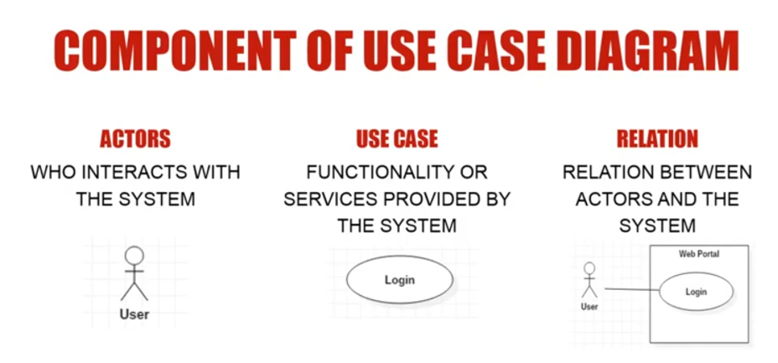
Use Case Diagram
Stick man icon denotes an actor
A name with in an ellipse denotes a use case.
Solid line connect use cases to participating actors.

Slide 8
Use Cases
A use case is a coherent piece of functionality that a system can provide by interacting with actors.
For ex a customer actor can buy a beverage from a vending m/c ,repair tech can perform schedule maintenance on a vending m/c etc..
Each use case involve one or more actors.
A use case involves sequence of messages among system and its actor.
Error condition is also a part of use case.

Slide 9
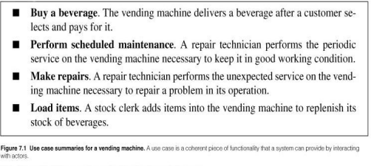
Use Case summarization for a Vending Machine.

Slide 10
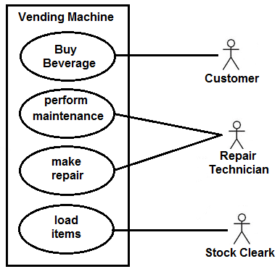
7.1.3 Use Case Diagram for Vending Machine
In the above figure ,actor repair technician participates in two use cases, the other in one each.

Slide 11
Use case description.
Use Case :Buy a beverage
Summary: A vending machine delivers a beverage after customers selects and pays for it.
Actors: Customer
Pre Condition: The machine is waiting for money to be inserted.
Description: The machine starts and says “Enter Coins”. A customer inserts coin into the machine. The machine displays the total value of money entered and lights up the button for item to be selected. The customer selects the item . The machine dispenses the item and makes change ,if the cost of the item is less than the money inserted.
Exceptions:
Canceled
Out of stock
Insufficient money
No change
Post Condition: The machine is waiting for money to be inserted.

Slide 12
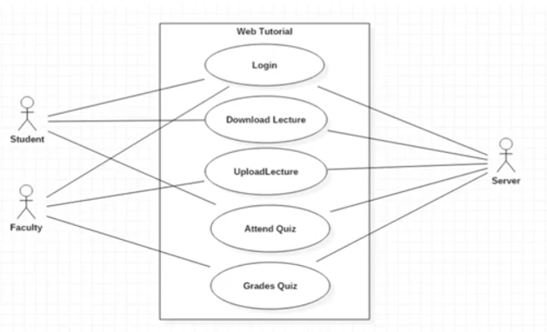
Use Case Diagram for Web Tutorial.

Slide 13
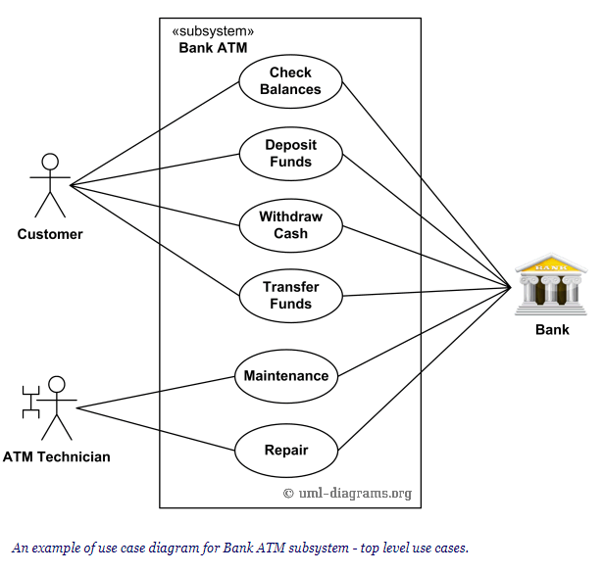
Example: Use case diagram for Bank ATM .
Notes:
Example: Use case diagram for Bank ATM .

Slide 14
7.1.4 Guidelines for Use Case Models
Use case identify the functionality of a system and organize it according to the perspective of the users.
Some guidelines for constructing Use Case Models are:
First determine the system boundaries-
Identify use cases or actors
Ensure that actors are focused-
Each actor should have a single, coherent purpose.
Real-world objects embodies multiple purpose may be with separate actors
Each use case must provide value to users-
Relate use cases and actors-
Remember that use cases are informal-
Use cases can be structured-

Slide 15
1 (a) Consider a physical bookstore, such as in a shopping mall:
i) List three actors that are involved in the design of a checkout system. Explain the relevance of each actor.
ii) One use case is the purchase of items. List another use case at a comparable level of abstraction. Summarize purpose of each use case with a sentence.
iii) Prepare use case diagram for a physical bookstore checkout system.

Slide 16
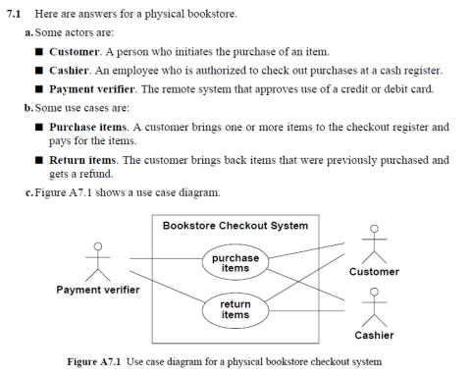

Slide 17
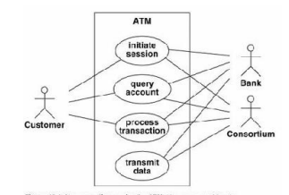
7 (a) For an ATM example:
1. Analyze the different use cases by designing a use case diagram.

Slide 18
2.Process transaction Scenario
ATM displays a menu of accounts and commands. User selects an account withdrawal.
ATM asks for the amount of cash.
User enters 10000.
ATM verifies that the withdrawal satisfies its policy limits.
ATM contacts the consortium and bank and verifies that the account has sufficient funds.
ATM dispenses the cash and asks the user to take it.
User takes the cash.
ATM displays a menu of accounts and commands.

Slide 19
3.Bring out initial and final events for each of the use cases.
4. Find initial and final events ATM example
Initial session
– Initial event :The customer’s insertion of a cash card.
– final event: The system keeps the cash card, or The system returns the cash card.
Query account
– Initial event : A customer’s request for account data.
– final event: The system’s delivery of account data to the customer.
Process transaction
– Initial event The customer’s initiation of a transaction.
– final event Committing or Aborting the transaction ATM example
Transmit data
– Initial event Triggered by a customer’s request for account data, or Recovery from a network, power, or another kind of failure.
– final event Successful transmission of data.

Slide 20
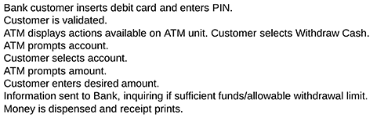
7.2 Sequence Models
Sequence models elaborates the themes of use cases.
There are two kinds of sequence models: Scenarios and more structured format called Sequence diagrams.
7.2.1 Scenarios:
Def: “A scenario is a sequence of events that occurs during one particular execution of a system, such as for a use case”.
A scenario can be displayed as a list of text statements as shown below
Withdraw money from ATM

Slide 21
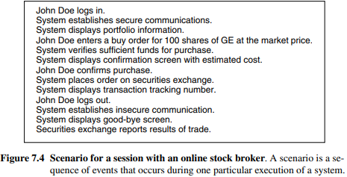
7.2 Sequence Models: Scenarios
A scenario contains messages between objects as well as activities performed by objects.
Each message transmits a information from one object to another.
Figure 7.4 illustrates A scenario can be displayed as a list of text statements. In this example, John Doe logs on with an online stock broker system, places an order for GE stock, and then logs off. Sometime later, after the order is executed, the securities exchange reports the results of the trade to the broker system. John Doe will see the results on the next login, but that is not part of this scenario.
Notes:
.A scenario contains messages between objects as well as activities performed by objects.
Each message transmits a informatio from one object to another.

Slide 22
7.6 ) Write scenarios for the following situations:
Moving a bag of corn, a goose and a fox across a river in a boat. Only one thing may be carried in the boat at a time. If the goose is left alone with the corn, the corn will be eaten. If the goose is left alone with the fox, the goose will be eaten. Prepare 2 scenarios, one in which something gets eaten and one in which everything is safely transported across the river.

Slide 23
Solution.
a.) Assume that everything starts out on the east side of river and is to be moved to the west side.
A scenario in which nothing gets eaten: (Farmer, fox, goose, corn all on W.)
Farmer takes goose to E.
Farmer returns alone to W.
Farmer takes fox to E.
Farmer takes goose to W.
Farmer takes corn to E.
Farmer returns alone to W.
Farmer takes goose to E. (Farmer, fox, goose, corn all on E.)
A scenario in which something gets eaten: (Farmer, fox, goose, corn all on W.)
Farmer takes goose to E.
Farmer returns alone to W.
Farmer takes corn to E.
Farmer returns alone to W.
Goose eats corn.
Farmer takes fox to E. (Farmer, fox, goose on E. Corn is gone.)

Slide 24
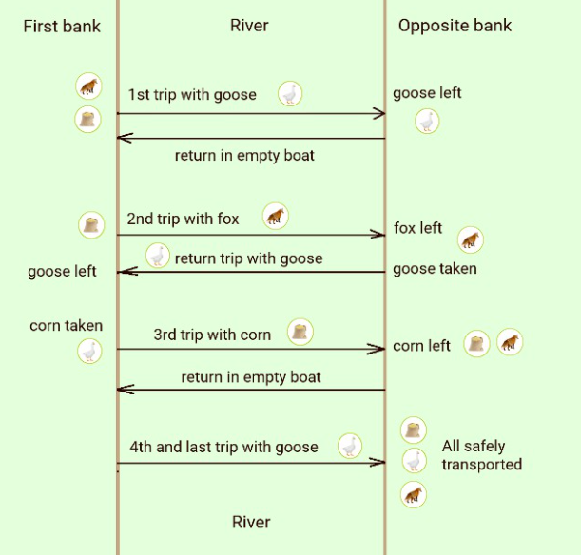

Slide 25
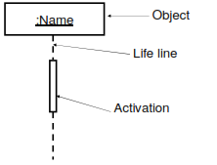
7.2 Sequence Models
7.2.2 Sequence Diagrams:
Def: “A Sequence diagram shows the participants in an interaction and the sequence of messages among them”.
A Sequence diagram shows the interaction of a system with its actor to perform all or part of a use case.
Each Actor or System is represented by Vertical Line called Lifeline
Sequence diagrams consists of :
Active Objects,
Messages and
Time

Slide 26
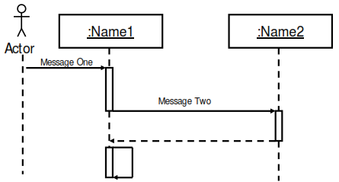
7.2 Sequence Models
7.2.2 Sequence Diagrams:
Sequence Diagram – Time and Message

Slide 27
SEQUENCE DIAGRAM
Figure 7.5 shows a sequence diagram corresponding to the stock broker scenario.
Each actor as well as the system is represented by a vertical line called a lifeline and each message by a horizontal arrow from the sender to the receiver.
Time proceeds from top to bottom, but the spacing is irrelevant; the diagram shows only the sequence of messages, not their exact timing. (Real-time systems impose time constraints on event sequences, but that requires extra notation.)
Each use case requires one or more sequence diagrams to describe its behavior. Each sequence diagram shows a particular behavior sequence of the use case.

Slide 28
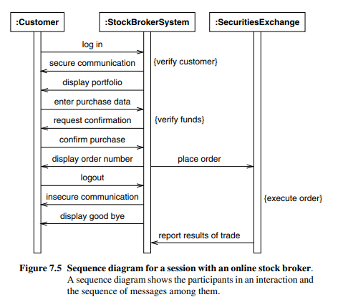
SEQUENCE DIAGRAM for a session with online stock broker

Slide 29
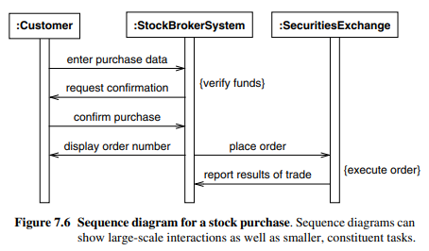
Sequence diagram for a stock purchase

Slide 30
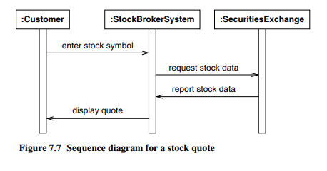
Sequence diagram for stock quote

Slide 31
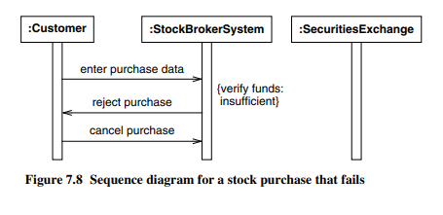
Sequence diagram for a stock purchase that fails.
An exception condition within the use case that fails .
For example, Figure 7.8 shows a variation in which the customer does not have sufficient funds to place the order. In this example, the customer cancels the order.
Notes:
An exception condition within the use case that fails .

Slide 32
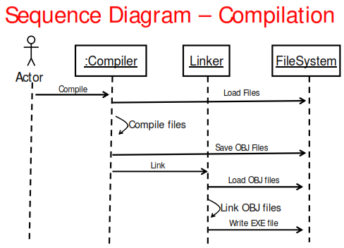
Example Compilation

Slide 33
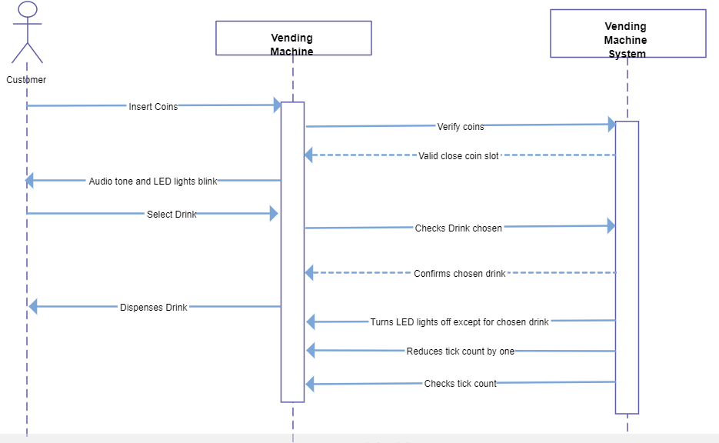
Vending machine sequence diagram.

Slide 34
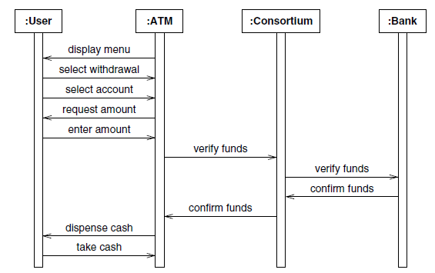
ATM Example

Slide 35
7.2 Sequence Models
7.2.3 Guidelines for Sequence Diagrams:
Prepare at least one scenario per use case.
Steps in Scenario should be logical commands, not indusial button clicks.
Abstract the scenario into sequence diagrams.
Shows the contribution of each actors.
Divide complex interactions
Break large interaction into smaller tasks.
Prepare a sequence diagram for each error condition
Shows system response to error condition

Slide 36
7.3 Activity Models
Def: “An Activity diagram shows the sequence of steps that make up a complex process, such as an algorithm or workflow”.
An activity diagram is a behavioral diagram i.e. it depicts the behavior of a system.
Activity diagram shows flow of control, similar to a sequence diagram, but focuses on operations rather than on objects.
Activity diagrams are most useful during the early stages of designing algorithms and workflows.
Activity diagram is like a traditional flowchart in that it shows the flow of control from step to step

Slide 37
7.3 Activity Models
Activities
Branches
Initiation and termination
Concurrent Activities
Executable Activities

Slide 38
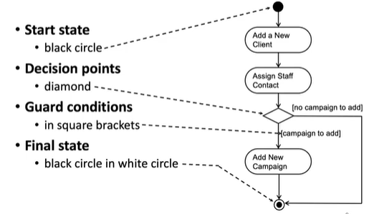
Notation Initiation and Termination

Slide 39
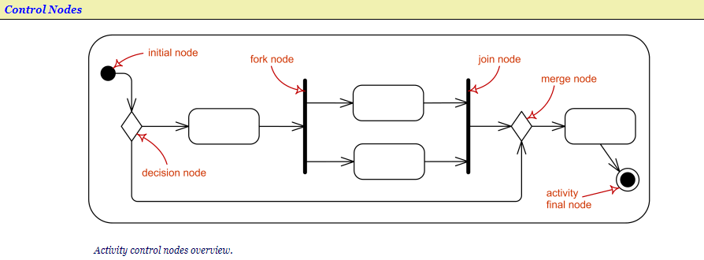
Activity Models
Activity Diagram Notation Summary

Slide 40
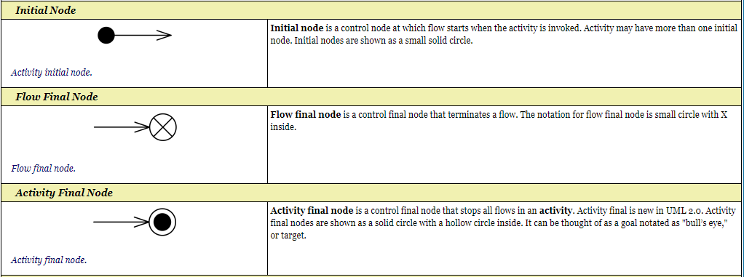
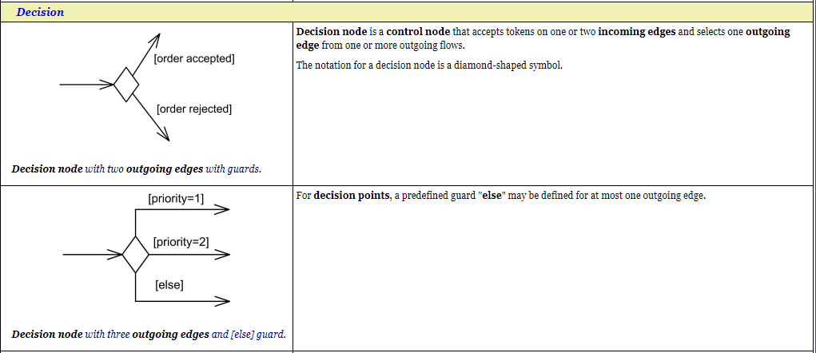

Slide 41
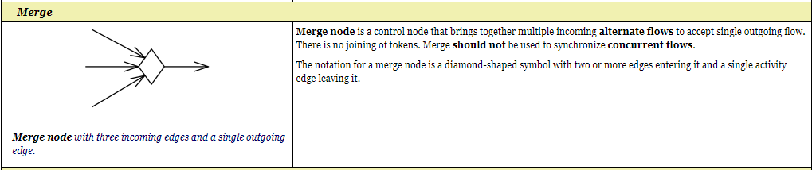
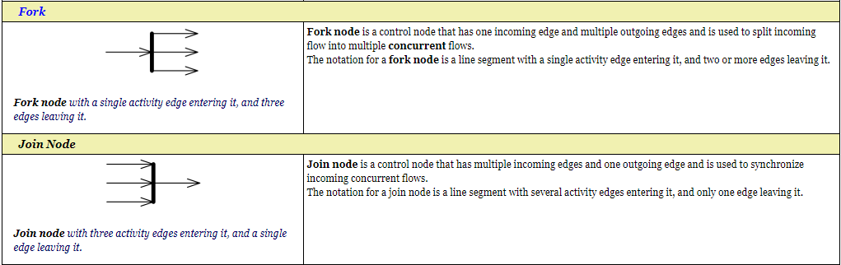

Slide 42
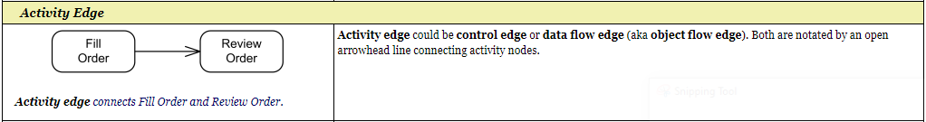
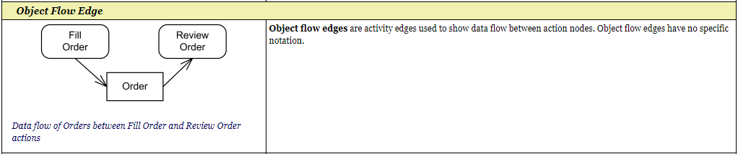

Slide 43
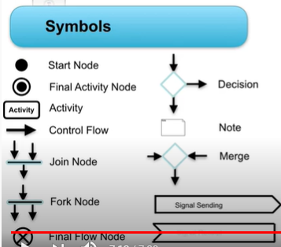

Slide 44
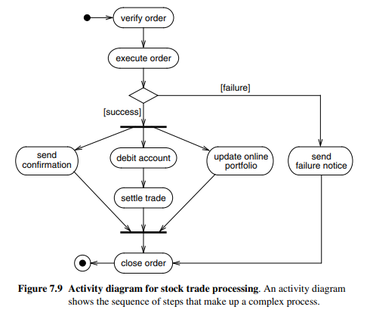
7.3 Activity Models
Figure 7.9 shows an activity diagram for the processing of a stock trade order that has been received by an online stock broker. The elongated ovals show activities and the arrows show their sequencing. The diamond shows a decision point and the heavy bar shows splitting or merging of concurrent threads

Slide 45
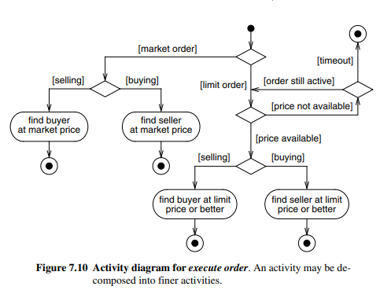
7.3 Activity Models
An activity may be decomposed into finer activities. For example, Figure 7.10 expands the execute order activity of Figure 7.9. It is important that the activities on a diagram be at the same level of detail. For example, in Figure 7.9 execute order and settle trade are similar in detail; they both express a high-level operation without showing the underlying mechanisms.

Slide 46
7.2.6 Guidelines for Activity Models:
Don’t misuse activity diagrams :Activity diagrams supplement the object-oriented focus of UML models and should not be used as an excuse to develop software via flowcharts.
Level Diagrams: Activities on a diagram should be at a consistent level of detail. Place additional detail for an activity in a separate diagram.
Be careful with branches and conditions: If there are conditions, at least one must be satisfied when an activity completes—consider using an else condition. In undeterministic models, it is possible for multiple conditions to be satisfied—otherwise this is an error condition
Be careful with concurrent activities: Concurrency means that the activities can complete in any order and still yield an acceptable result. Before a merge can happen, all inputs must first complete
Consider executable activity diagrams: Executable activity diagrams can help developers understand their systems better.

Slide 47
Activity diagram for an order management system
Example of an activity diagram for order management system. In the diagram, four activities are identified which are associated with conditions. One important point should be clearly understood that an activity diagram cannot be exactly matched with the code. The activity diagram is made to understand the flow of activities and is mainly used by the business users
Following diagram is drawn with the four main activities −
Send order by the customer
Receipt of the order
Confirm the order
Dispatch the order
After receiving the order request, condition checks are performed to check if it is normal or special order. After the type of order is identified, dispatch activity is performed and that is marked as the termination of the process.

Slide 48
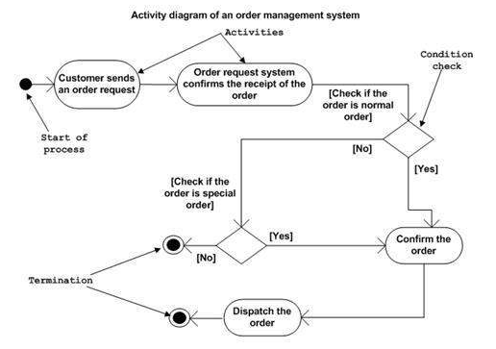
Activity diagram for an order management system
Following diagram is drawn with the four main activities −
Send order by the customer
Receipt of the order
Confirm the order
Dispatch the order

Slide 49
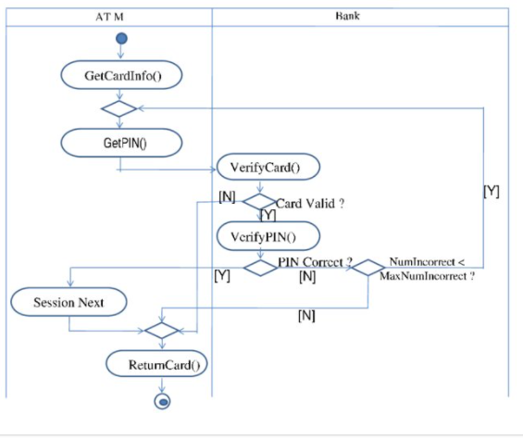
With the help of activity diagram, show the possible responses for the verification of card inserted by the user at the ATM.

Slide 50
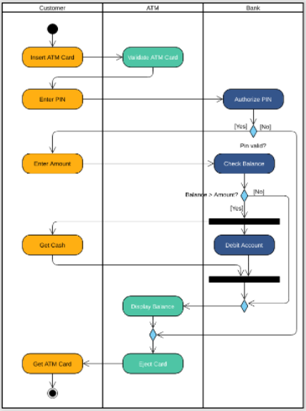

Slide 51
Unit-III
Advanced Interaction Modeling

Slide 52
Topics Covered
Use case Relationships
1) Include Relationship
2)Extend Relationship
3) Generalization
4)Combinations of Use Case Relationships
5)Guidelines for Use Case Relationships
Procedural Sequence Models
1)Sequence Diagrams with Passive Objects
2)Sequence Diagrams with Transient Objects
3)Guidelines for Procedural Sequence Models
Special Constructs for Activity Models
1)Sending and Receiving Signals
2)Swimlanes
3)Object Flows

Slide 53
Use case Relationships
Complex use cases can be built from smaller pieces of use case relationship.
There are three kinds of relationships between use cases :
Include Relationship ---Examples: <<include>> for common behaviour
Extend Relationship -----<<extend>> for special cases:
Generalization Relationship
Include Relationship :The include relationship incorporates one use case within the behavior sequence of another use case
An included use case is like a subroutine—it represents behavior that would otherwise have to be described repeatedly.
The UML notation for an include relationship is a dashed arrow from the source (including) use case to the target (included) use case. The keyword «include» annotates the arrow
The include relationship could be used:
to simplify large use case by splitting it into several use cases,
to extract common parts of the behaviors of two or more use cases.

Slide 54
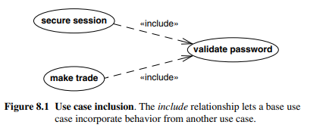
Include Relationship
Figure 8.1 shows an example from an online stock brokerage system. Part of establishing a secure session is validating the user password. In addition, the stock brokerage system validates the password for each stock trade. Use cases secure session and make trade both include use case validate password.
When two or more use cases have some common behavior, this common part could be extracted into a separate use case to be included back by the use cases with the UML include relationship.

Slide 55
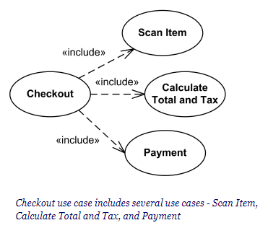
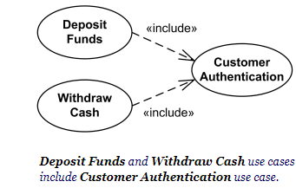
Example
Include relationship between use cases is shown by a dashed arrow with an open arrowhead from the including (base) use case to the included (common part) use case.
The arrow is labeled with the keyword «include».
Note, that including Checkout use case becomes incomplete by itself and requires included use cases to be complete.

Slide 56
Extend Relationship
The extend relationship adds incremental behavior to a use case. It is like an include relationship looked at from the opposite direction, in which the extension adds itself to the base, rather than the base explicitly incorporating the extension.
The include and extend relationships both add behavior to a base use case.
The UML notation for an extend relationship is a dashed arrow from the extension use case to the base use case.
The keyword «extend» annotates the arrow.

Slide 57
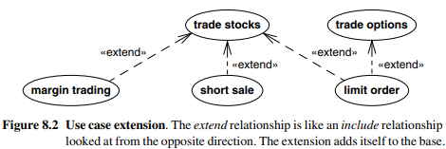
Extend Relationship
Figure 8.2 shows the base use case trade stocks for a stock brokerage system. The base use case permits simple purchases and sales of a stock at the market price. The brokerage system adds three capabilities: buying a stock on margin, selling a stock short, and placing a limit on the transaction price. The use case trade options also has an extension for placing a limit on the transaction price

Slide 58
Generalization
It is a parent-child relationship between two or more use cause.
It is a kind of relationship in which the properties of the parent use case are inherited by the child use case.
Generalization can show specific variations on a general use case, analogous to generalization among classes. A parent use case represents a general behavior sequence. Child use cases specialize the parent by inserting additional steps or by refining steps
The UML indicates generalization by an arrow with its tail on the child use case and a triangular arrowhead on the parent use case, the same notation that is used for classes

Slide 59
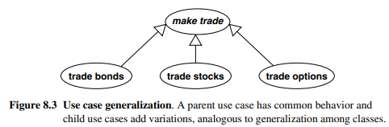
For example, an online stock brokerage system (Figure 8.3) might specialize the general use case make trade into the child use cases trade bonds, trade stocks, and trade option
The parent use case contains steps that are performed for any kind of trade, such as entering the trading password.
Each child use case contains the additional steps particular to a specific kind of trade, such as entering the expiration date of an option.
Notes:
For example, an online stock brokerage system (Figure 8.3) might specialize the general use case make trade into the child use cases trade bonds, trade stocks, and trade option

Slide 60
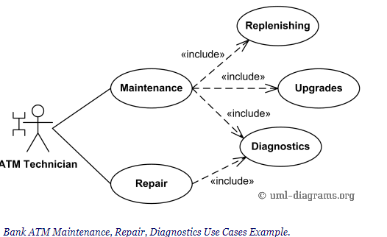
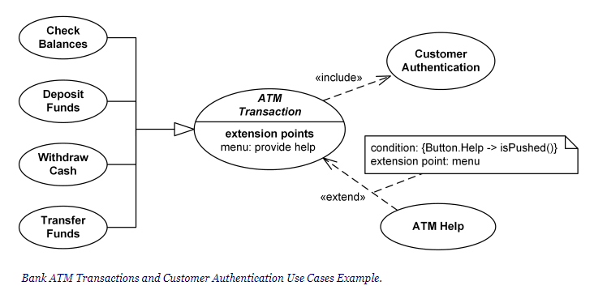
Include ,Extend, Generalization for ATM example

Slide 61
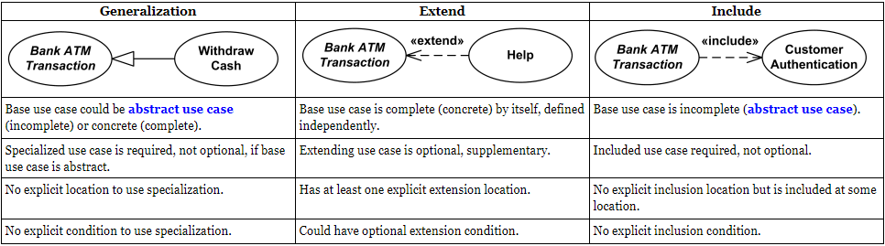
Use case Relationships compared
Notes:
Usecase Relationships compared

Slide 62
Combinations of Use Case Relationships
A single diagram may combine several kinds of use case relationships.
Figure 8.4 shows a use case diagram from a stock brokerage system.
The secure session use case includes the behavior of the validate password, make trade, and manage account use cases.
Make trade is an abstract parent with the children—trade bonds, trade stocks, and trade options.
Use case make trade also includes the behavior of validate password. The brokerage system validates the password once per session and additionally for every trade
The use case margin trading extends both trade bonds and trade stocks—a customer may purchase stocks and bonds on margin, but not options.
Use case limit order extends abstract use case make trade—limit orders apply to trading bonds, stocks, and options.
We assume that a short sale is only permitted for stocks and not for bonds or options.

Slide 63
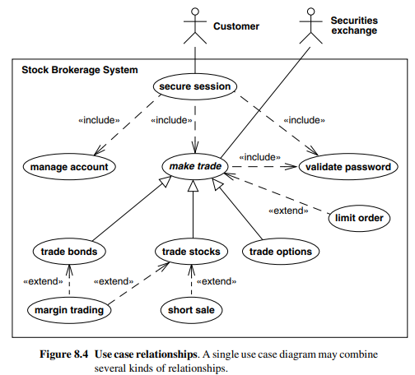
Combinations of Use Case Relationships

Slide 64
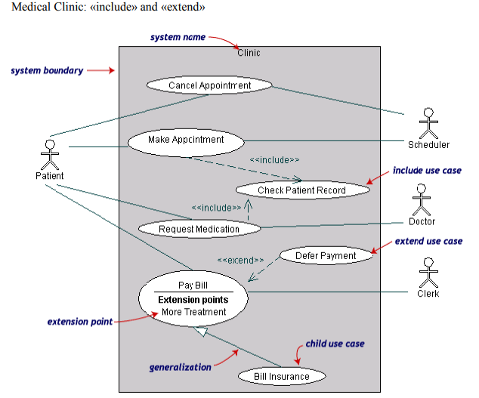

Slide 65
Guidelines for Use Case Relationships
1 . Use case generalization:If a use case comes in several variations, model the common behavior with an abstract use case and then specialize each of the variations.
2. Use case inclusion:If a use case includes a well-defined behavior fragment that is likely to be useful in other situations, define a use case for the behavior fragment and include it in the original use case. In most cases, you should think of the included use case as a meaningful activity but not as an end in itself. For example, validating a password is meaningful to users but has a purpose only within a broader context.
3. Use case extension: We can model the use case with optional features, model the base behavior as a use case and add features with the extend relationship. This permits the system to be tested and debugged without the extensions, which can be added later. Use the extend relationship when a system might be deployed in different configurations, some with the additional features and some without them.

Slide 66
Guidelines for Use Case Relationships
4. Include relationship vs. extend relationship :The include relationship, however, implies that the included behavior is a necessary part of a configured system (even if the behavior is not executed every time), whereas the extend relationship implies that a system without the added behavior would be meaningful (even if there is no intention to configure it that way).
OR
"The include relationship is intended for reusing behavior modeled by another use case, whereas the extend relationship is intended for adding parts to existing use cases as well as for modeling optional system services“

Slide 67
Procedural Sequence Models
Sequence diagrams containing independent objects, all of which are active concurrently.
An object remains active after sending a message and can respond to other messages without waiting for a response.
This is appropriate for high-level models.
However, most implementations are procedural and limit the number of objects that can execute at a time.
The UML has elaborations for sequence diagrams to show procedural calls.
With procedural code all objects are not constantly active. Most objects are passive and do not have their own threads of control.
A passive object is not activated until it has been called. Once the execution of an operation completes and control returns to the caller, the passive object becomes inactive

Slide 68
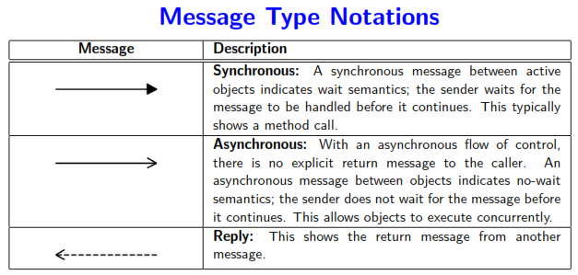
7.2 Sequence Models
7.2.2 Sequence Diagrams:

Slide 69
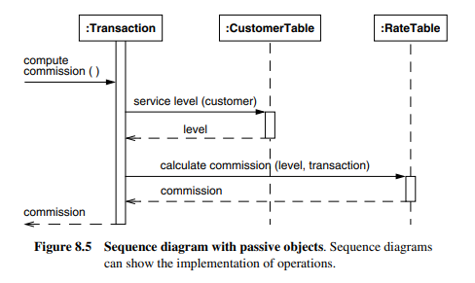
Sequence Diagrams with Passive Objects
The transaction object receives a request to compute its commission. It obtains the customer’s service level from the customer table, then asks the rate table to compute the commission based on the service level, after which it returns the commission value to the caller.
The UML shows the period of time for an object’s execution as a thin rectangle. This is called the activation or focus of control.
The period of time when an object exists but is not active is shown as a dashed line.
The entire period during which the object exists is called the lifeline, as it shows the lifetime of the object.

Slide 70
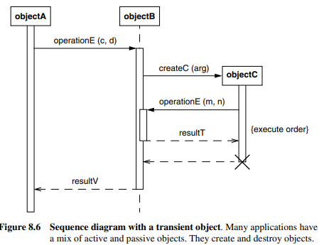
Sequence Diagrams with Transient Objects
ObjectA is an active object that initiates an operation. Because it is active, its activation rectangle spans the entire time shown in the diagram.
ObjectB is a passive object that exists during the entire time shown in the diagram, but it is not active for the whole time.
The UML shows its existence by the dashed line (the lifeline) that covers the entire time period..

Slide 71
Sequence Diagrams with Transient Objects
Fig 8.6 ObjectB’s lifeline broadens into an activation rectangle when it is processing a call
During part of the time, it performs a recursive operation, as shown by the doubled activation rectangle between the call by objectC on operationE and the return of the result value. ObjectC is created and destroyed during the time shown on the diagram, so its lifeline does not span the whole diagram.
The notation for a call is an arrow from the calling activation to the activation created by the call. The tail of the arrow is somewhere along the rectangle of the calling activation. The arrowhead aligns with the top of the rectangle of the newly created activation, because the call creates the activation. The filled arrowhead indicates a call
The UML shows a return by a dashed arrow from the bottom of the called activation to the calling activation. Not all return arrows have result values—for example, the return from objectC to objectB.

Slide 72
Guidelines for Procedural Sequence Models
Active vs. passive objects: Differentiate between active and passive objects. Most objects are passive and lack their own thread of control. By definition, active objects are always activated and have their own focus of control.
Advanced features: Advanced features can show the implementation of sequence diagrams. Be selective in using these advanced features. Only show implementation details for difficult or especially important sequence diagrams.

Slide 73
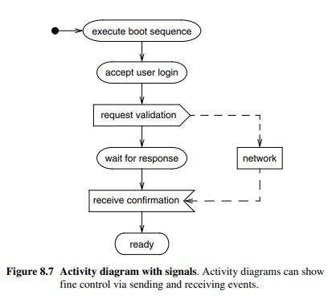
Special Constructs for Activity Models
Activity diagrams have additional notation that is useful for large and complex applications.
Sending and Receiving Signals: Consider a workstation that is turned on. It goes through a boot sequence and then requests that the user log in. After entry of a name and password, the workstation queries the network to validate the user. Upon validation, the workstation then finishes its startup process. Figure 8.7 shows the corresponding activity diagram.

Slide 74
Special Constructs for Activity Models
The UML shows the sending of a signal as a convex pentagon. When the preceding activity completes, the signal is sent, then the next activity is started.
The UML shows the receiving of a signal as a concave pentagon. When the preceding activity completes, the receipt construct waits until the signal is received, then the next activity starts.

Slide 75
Swimlanes
Swimlanes are columns with solid vertical lines on each side. Each swimlane represents the responsible class, person, or organizational unit.
Partitioning an activity diagram by dividing it into columns and lines. Each column is called a swimlane by analogy to a swimming pool. Placing an activity within a particular swimlane indicates that it is performed by a person or persons within the organization.
Lines across swimlane boundaries indicate interactions among different organizations, which must usually be treated with more care than interactions within an organization.
The horizontal arrangement of swimlanes has no inherent meaning, although there may be situations in which the order has meaning.

Slide 76
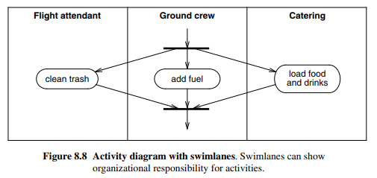
Swimlanes :Example
Figure 8.8 shows a simple example for servicing an airplane. The flight attendants must clean the trash, the ground crew must add fuel, and catering must load food and drink before a plane is serviced and ready for its next flight.

Slide 77
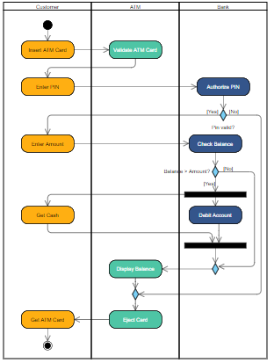
Swimlanes :ATM Example

Slide 78
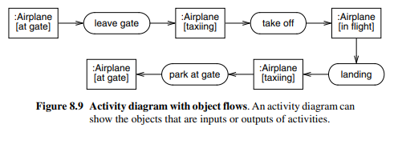
Object Flows
An activity diagram can show objects that are inputs to or outputs from the activities
UML shows an object value in a particular state by placing the state name in square brackets following the object name.
In Figure 8.9 an airplane goes through several states as it leaves the gate, flies, and then lands again.
In below figure the same object goes through several states during the execution of an activity diagram. The same object may be an input to or an output from several activities, but on closer examination an activity usually produces or uses an object in a particular state

Slide 79
Thank You

Slide 80
Questions.
Consider a physical bookstore, such as in a shopping mall. a. (2) List three actors that are involved in the design of a checkout system. Explain the relevance of each actor.
b. (2) One use case is the purchase of items. Take the perspective of a customer and list another use case at a comparable level of abstraction. Summarize the purpose of each use case with a sentence.
c. (4) Prepare a use case diagram for a physical bookstore checkout system. d. (3) Prepare a normal scenario for each use case. Remember that a scenario is an example, and need not exercise all functionality of the use case. e. (3) Prepare an exception scenario for each use case. f. (5) Prepare a sequence diagram corresponding to each scenario in (d)

Slide 81

ONLINE BOOK STORE SYSTEM

Slide 82


Slide 83

Use case description

Slide 84

Use case description

Slide 85

Use case description

Slide 86

Use case description

Slide 87

Use case description

Slide 88

Use case description

Slide 89

Use case diagram

Slide 90
THANK YOU

